Slide 1

Worldwide Recipes
By S17

Slide 2

What is it?

Slide 3

What problems do we address?

Slide 4

Why we chose this?

Slide 5
Documentation: MoSCow
Must:
English language support
View recipes
Usable on low-end devices
Free

Slide 6
Should:
Log in (Admins and Users)
User uploaded recipes

Slide 7
Could:
Map locations of food banks
Comment sections
Calculate average prices

Slide 8
Won’t:
Foreign language support
PDF downloads of recipes
Stocks of ingredients from local shops

Slide 9
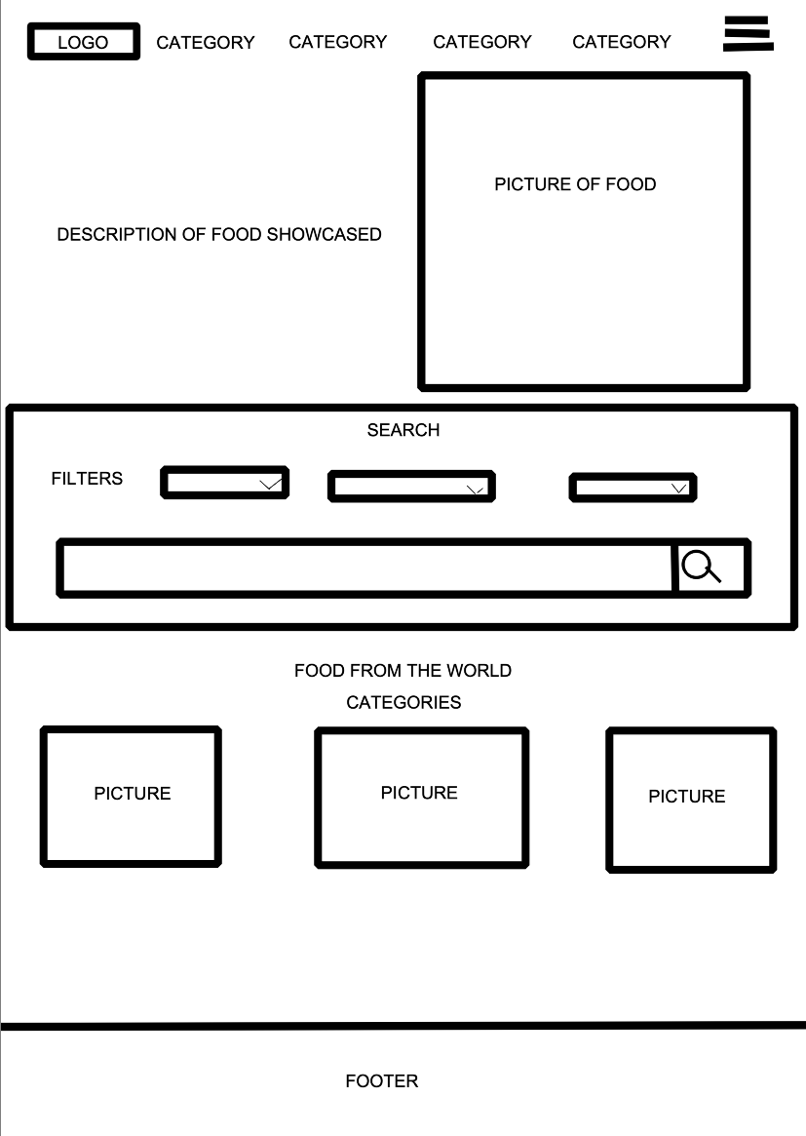
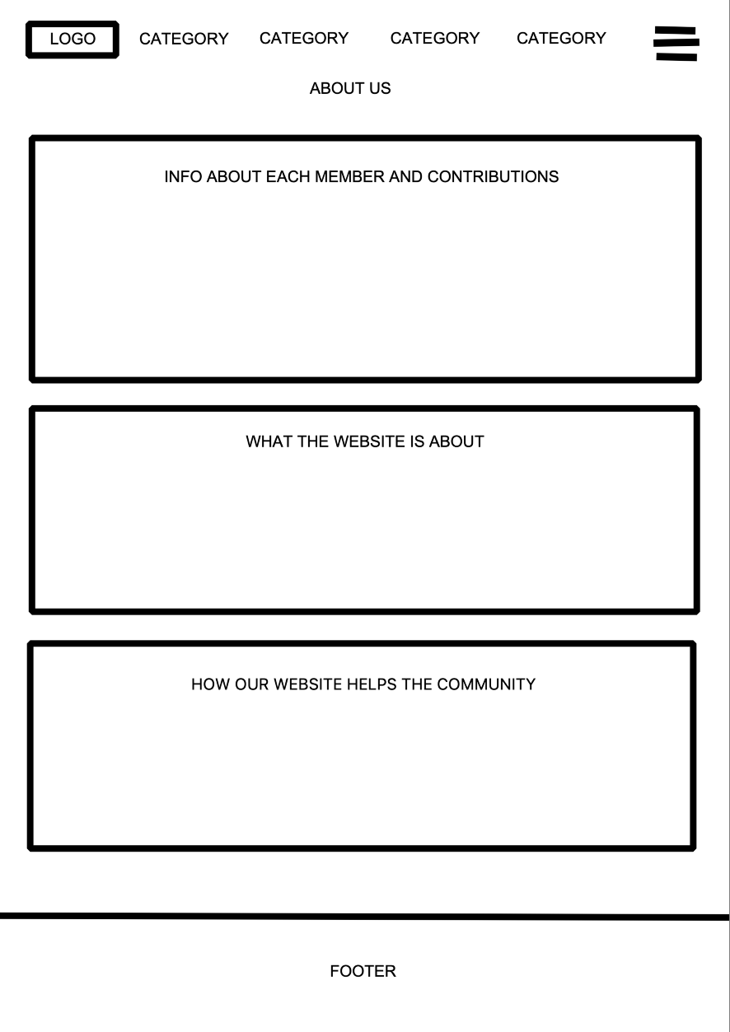
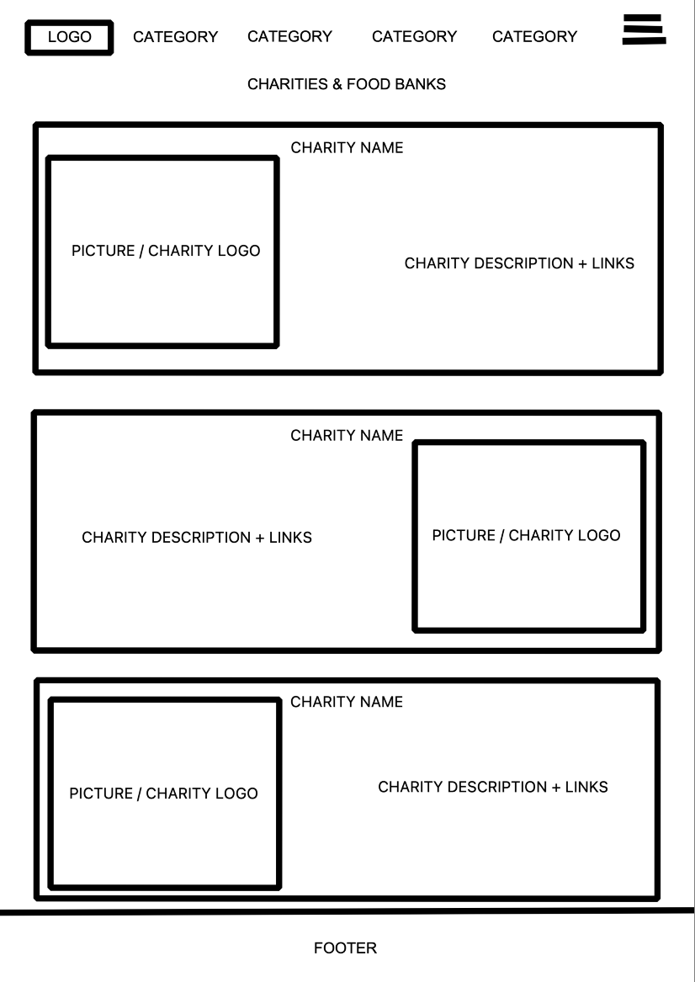
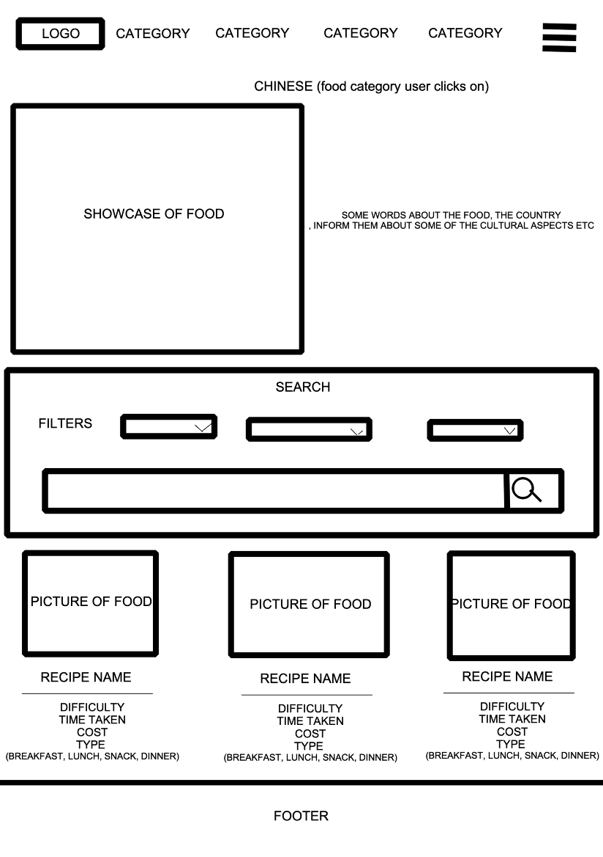
Documentation: Design Prototypes

Slide 10
Home page design
Simple, easy on the eye, minimal design
Search bar for searching food
Showcase of some food
Brief description of website

Slide 11
Recipes page design
Search filter for specific food
Show the recipes at the bottom
Recipe description for users to know how cheap, how long, how difficult and about the dish

Slide 12
Charities page
Simple layout showcasing each charity in blocks
Description of charity, logo and the link to it’s website shown

Slide 13
About us page
Page for users to find more information about us, the website and how the website will help the community
Simple, minimal website, organized each section into separate blocks

Slide 14
Documentation: User Personas
All live within Goven
3 are from Glasgow, but 2 are from abroad
Majority young, but some old
Different religions will have different needs

Slide 15
Persona 1: Jordan Crawford
Young adult
Apprentice at a BAE Systems shipyard
From Govan

Slide 16
Persona 2: Anthony Doyle
Pensioner
Retired
Born and raised in Govan

Slide 17
Persona 3: Heather Smith
Adult
Employed part time
Single mother
Born in Glasgow

Slide 18
Persona 4: Irena Burak
Young adult
Employed in the NHS
Financially stable
Born in Poland
Fluent in English

Slide 19
Elam Umrani
Young adult
Employed in the Civil Service
Refugee from the Middle East
Muslim
Proficient, but not fluent in English

Slide 20
Documentation: UML Diagram

Slide 21
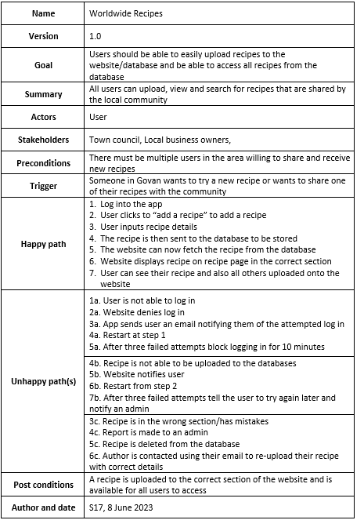
Documentation: Textual Use Case

Slide 22
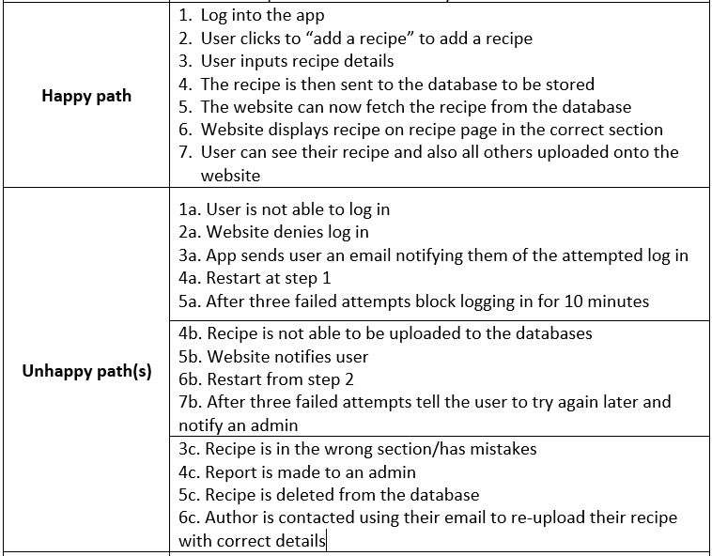

Slide 23
Documentation: E-R Diagram

Slide 24
Implementation

